Slide 1

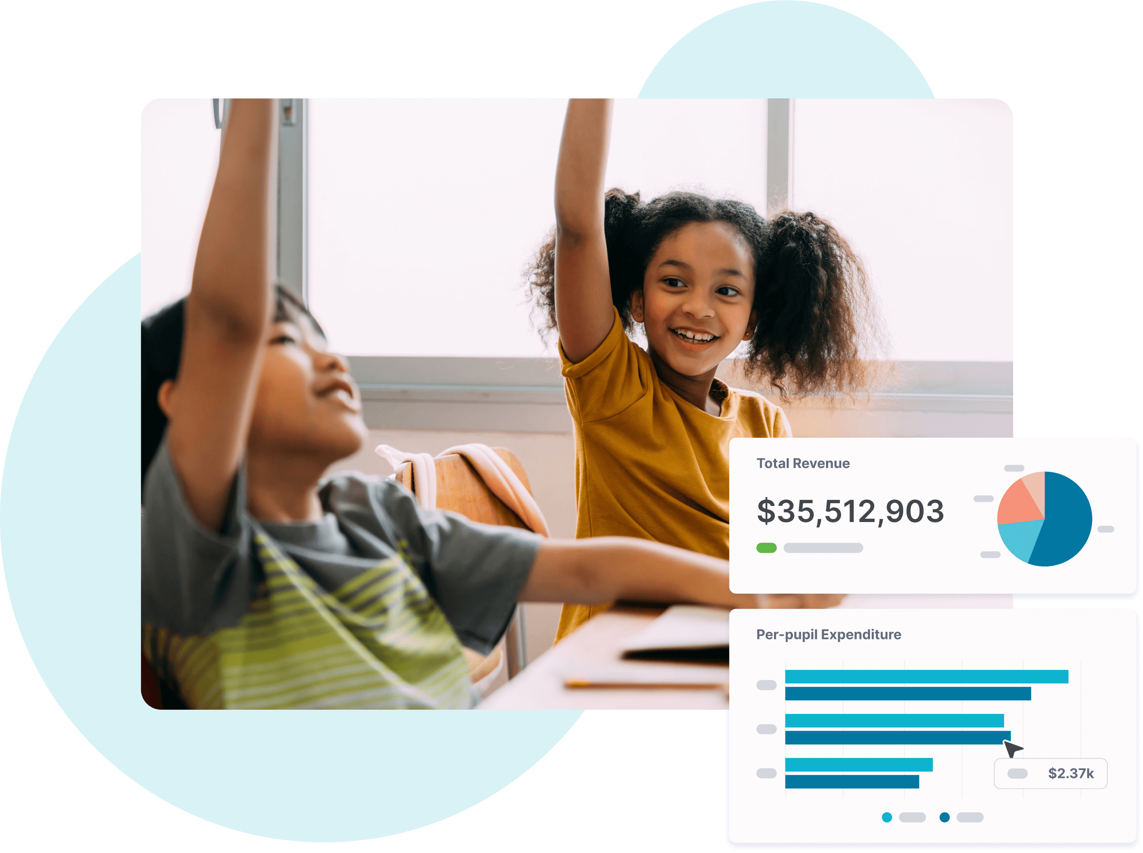
Introduction and
Training Guide

Slide 2

Overview
  History and legislation
  Data sources
  Navigating the Portal
  Other Context
2

Slide 3
HISTORY & LEGISLATION
Portal Legislation
The 2021 Arizona Revised Statute §15-747 requires the Arizona Department of Administration to develop a school financial transparency portal:
“Beginning in fiscal year 2021-2022, the department of administration shall develop a transparent and easily accessible school financial transparency portal that includes the following school level data for charter schools, individual schools operated by a school district and school districts:
The detailed total revenues generated by weighted student count.
The total allocated federal, state and local revenues.
The allocation of classroom site fund monies.
The amounts allocated for teacher pay and benefits, classroom supplies, student support and other expenditures.
A comparison of the funding information for each school in relation to the funding information for other schools in the same local education agency.
Any other information that is necessary for a transparent comparison between schools with respect to their revenues, expenditures, student demographics or academic achievement.”
3

Slide 4
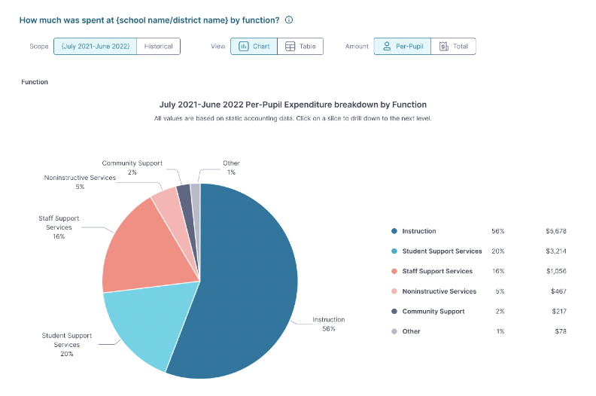
DATA SOURCES
Where does the data come from?
AZ Auditor General Annual Finance Report
This is filler text. This is some more filler text. Please delete this and enter your content here. This is filler text. This is some more filler text. Please delete this and enter your content here.
AZ Department of Education
This is filler text. This is some more filler text. Please delete this and enter your content here. This is filler text. This is some more filler text. Please delete this and enter your content here.
4

Slide 5
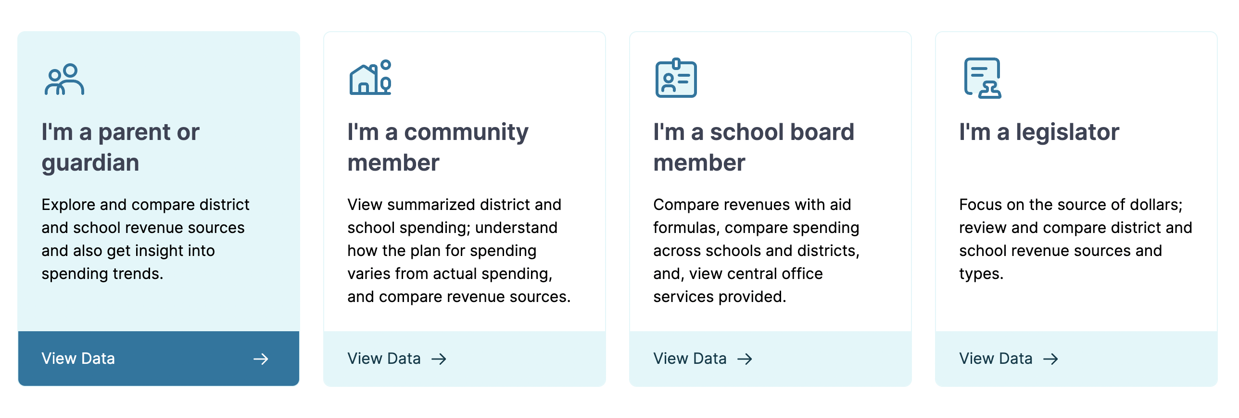
NAVIGATION
Choose your user experience
Guided experiences tailored to the interests of parents, legislators, school boards, and community members provide different perspectives on school spending data. Try them all to find the data view that best suits your needs or create your own comparison reports! Hover your cursor over any user type and click to try each user experience.
5

Slide 6
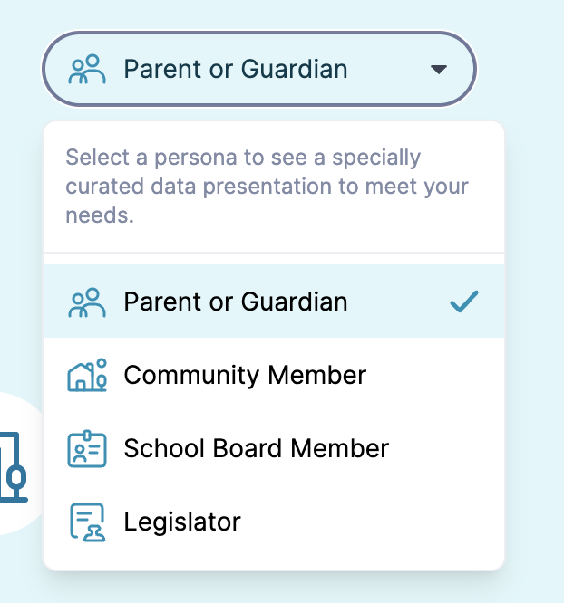
NAVIGATION
Change your user experience
You’ll always see your current user persona selection in the top right corner of every page. If you change your mind, click the drop-down menu to select a new persona.
The persona you've chosen will determine which graphs we show you. Swapping between personas will show you different charts and data points, so feel free to explore!
Hover your cursor over any user type and click to change your persona.
6

Slide 7
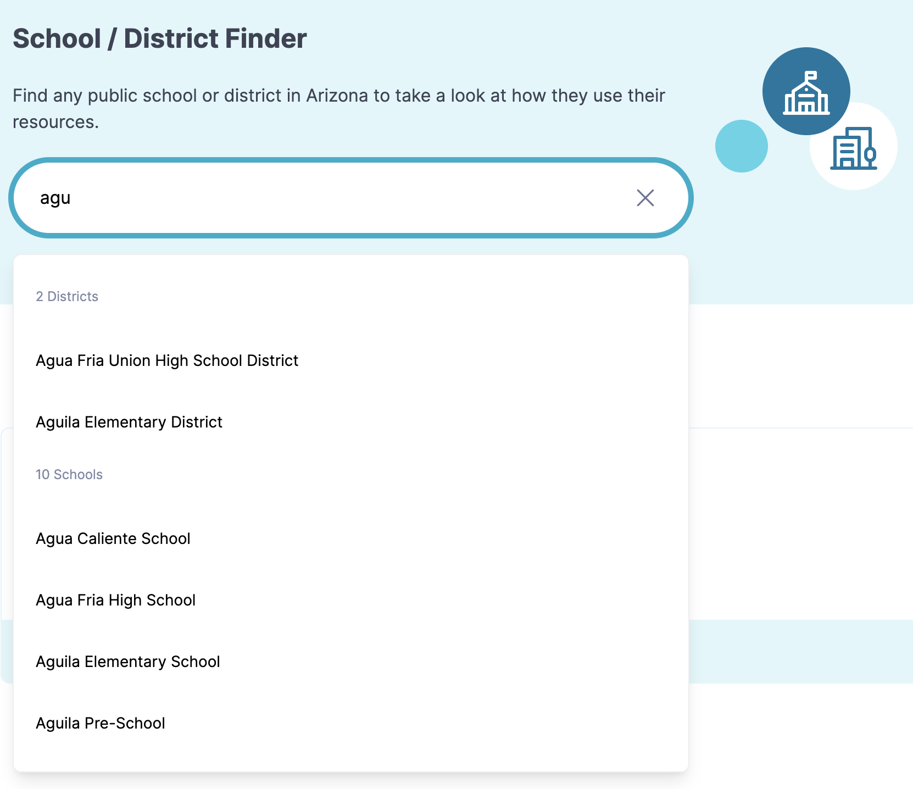
NAVIGATION
Select a school or district
Once you choose a persona, you’ll be prompted to choose a school or district to explore school spending data.
Start typing in the search bar to see a list of districts or schools to choose from. Click on any school or district to see a detailed data page.
7

Slide 8
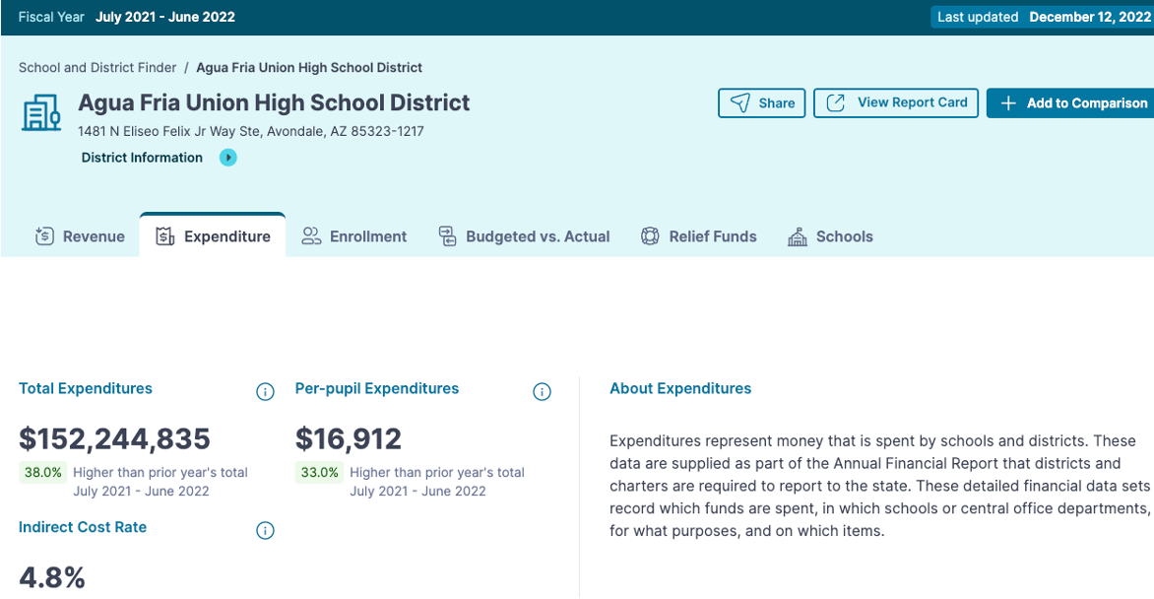
NAVIGATION
Explore the data
Every school or district page has tabs for you to explore detailed finance data.
To explore the data, click on any tab and scroll to see more interactive charts. Hover your cursor over any (i) for detailed definitions.
8

Slide 9
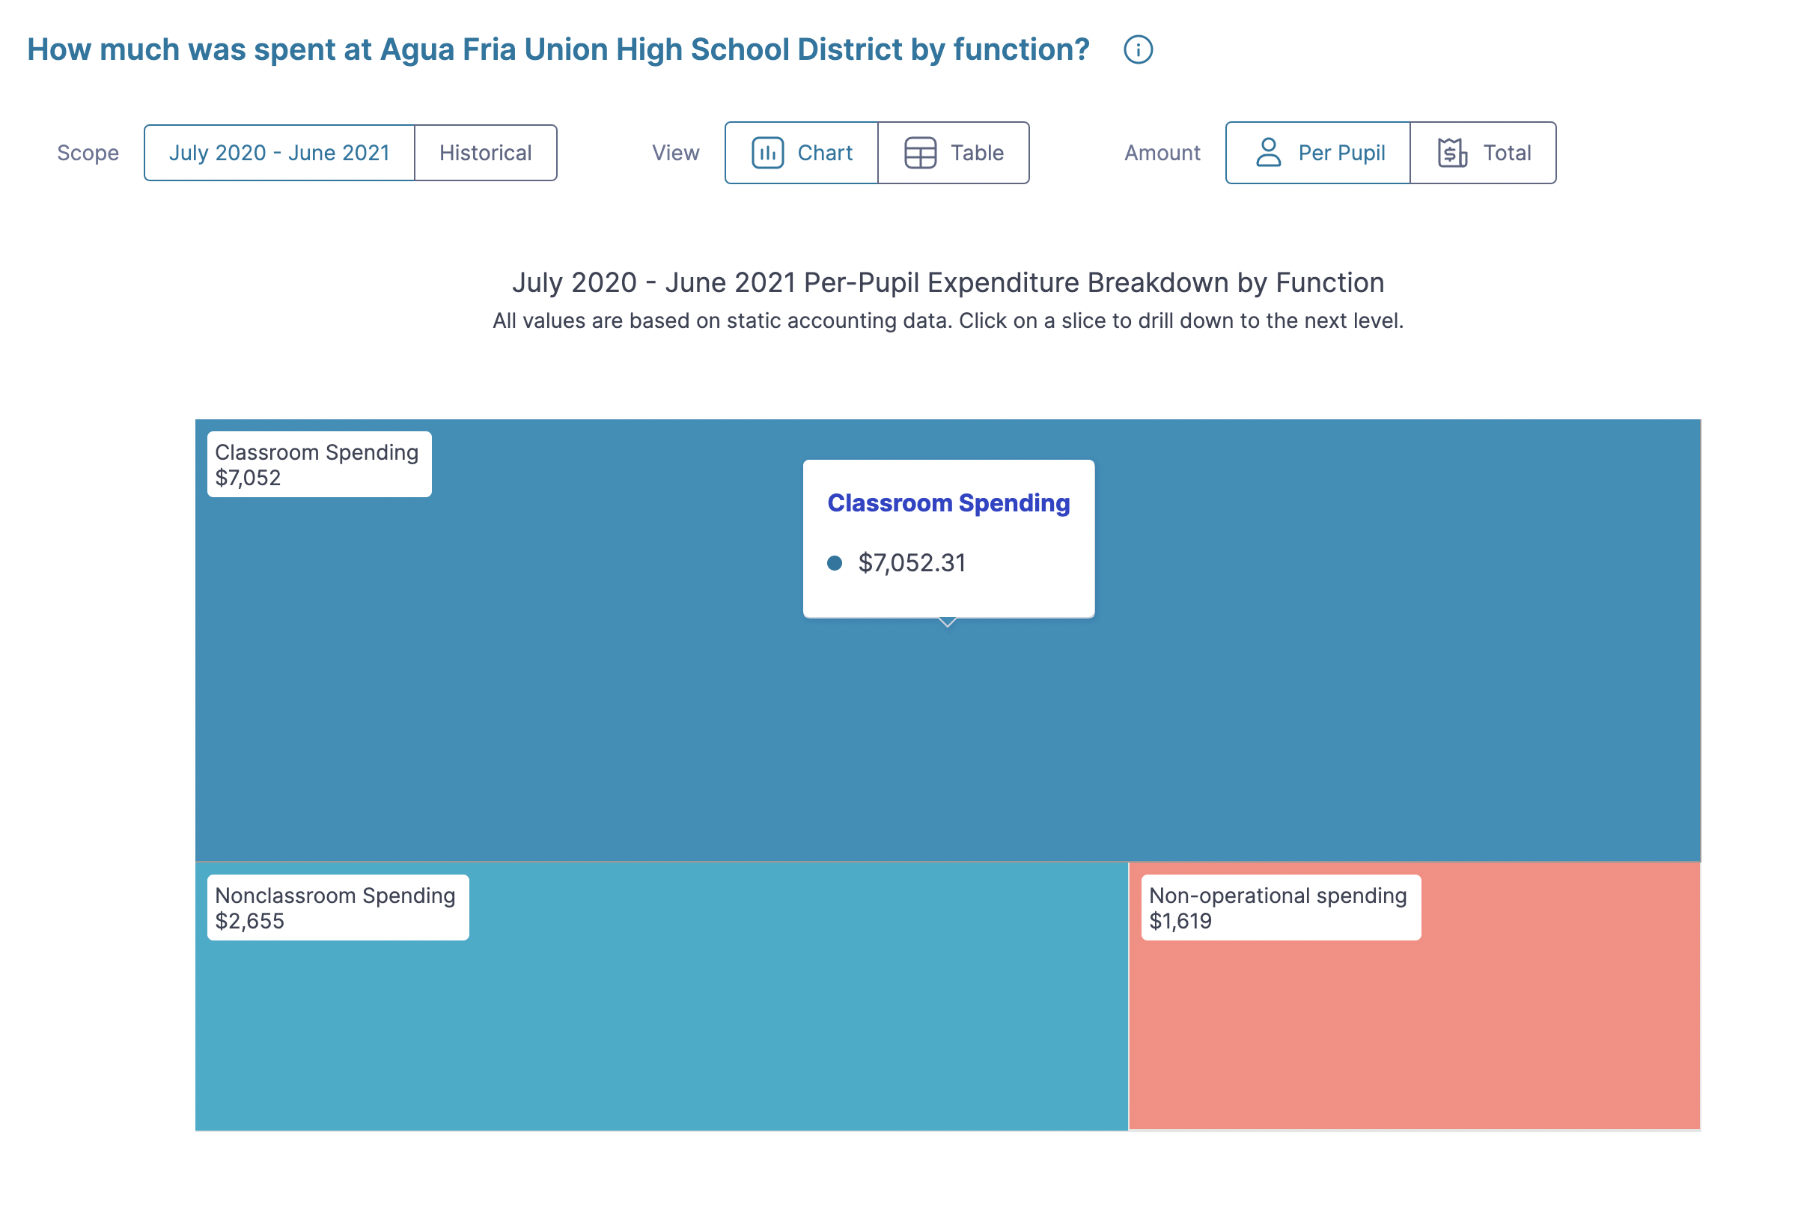
NAVIGATION
Explore the data
Charts are interactive—click around to see different views of the data. You can choose your:
scope (current year or historical);
view (chart or table); or
amount (per pupil or total).
Click on the tabs to see the data presented in different ways. Hover your cursor over any of the graph components and click to drill down to more detailed data for each spending category.
9

Slide 10
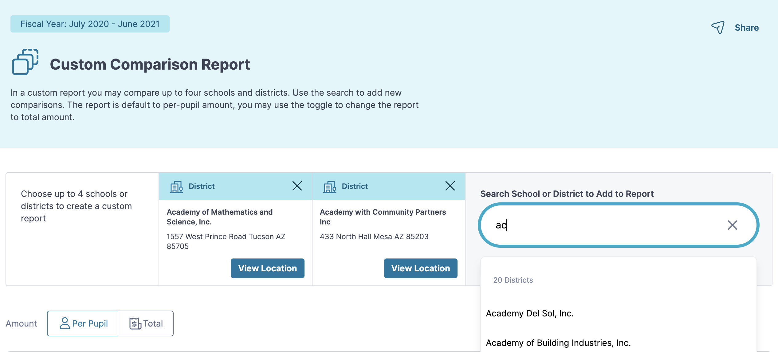
NAVIGATION
Create a custom report
If you want to compare data across schools or districts, you can create a custom report with up to 4 different schools or districts.
To add a school or district to your report, start typing in the search bar and click the name you want to add to your report.
Changed your mind? Click the X to remove a school or district from your report.
10

Slide 11
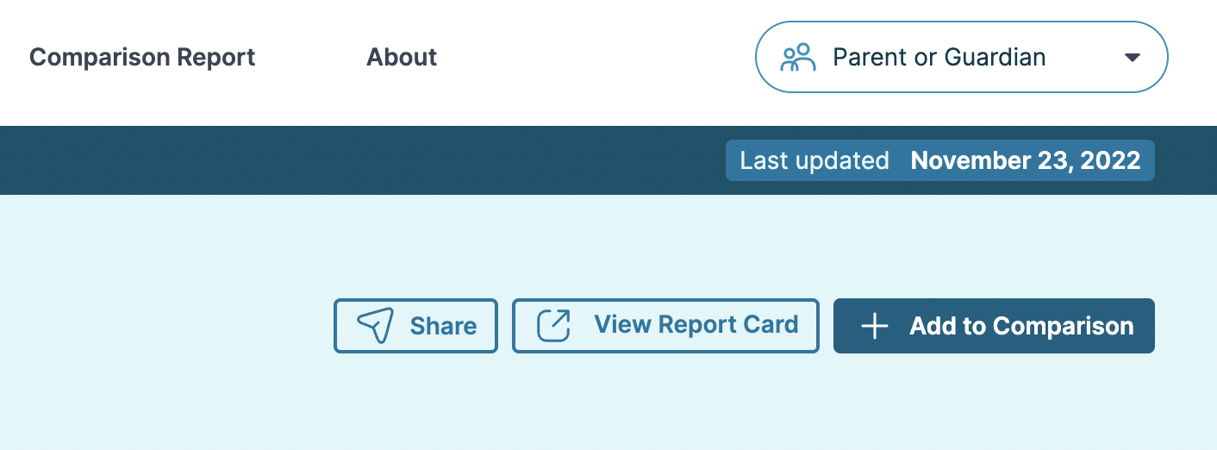
NAVIGATION
Create a custom report
You can also add a school or district to your comparison report directly from their page by clicking “Add to Comparison.”
Once you add a school or district to your comparison report, you’ll find it waiting for you in the Comparison Report tab.
11

Slide 12
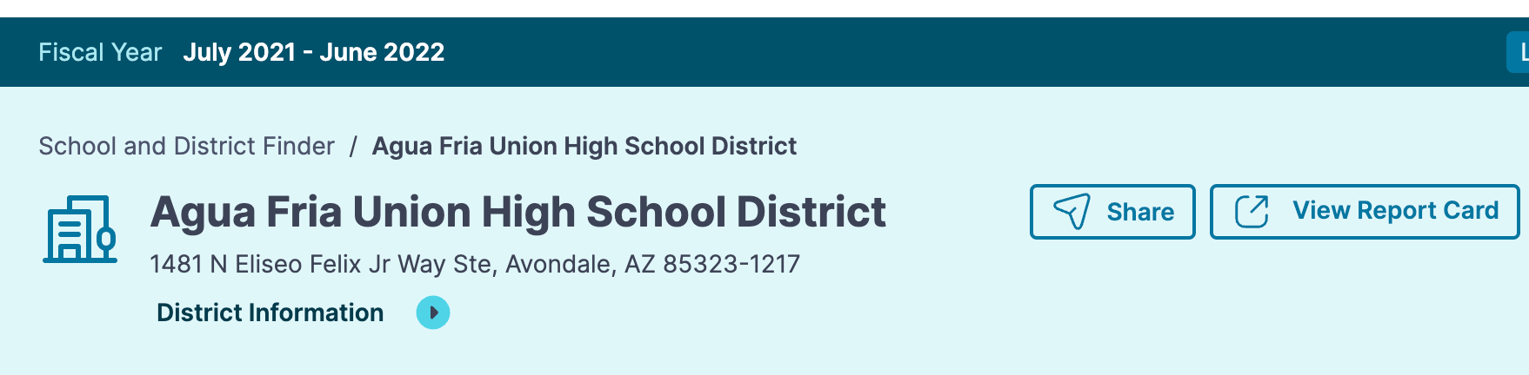
NAVIGATION
View report cards
While the Portal has so much to explore related the finances of schools, districts, and LEAs, there even more to learn about each organization. You can visit the school or district report card for each organization by clicking the “View Report Card” button. This information is published each year by the AZ Department of Education and contains results-based details as well as additional data about the student body at each location.
12

Slide 13
CONTEXT
Data is a tool
Education finance data is an incredibly valuable tool for asking questions and generating discussions about how states, districts, and schools allocate, budget, and spend resources in service of student learning achievement.
It’s important to remember that data is a tool, not an answer. Like any tool, data can be used to create value or cause confusion depending on how it is presented and contextualized.
Please remember to use this data to create value for your community by asking critical questions and generating thoughtful discussions. Remember: you can use the site to help explain concepts that are often hard for folks to understand.
13

Slide 14
CONTEXT
Context matters
Education finance data is complex and vast. There are numerous ways to slice and dice budget and spending data to tell a story, but the flip side is that any one number rarely tells the whole story.
Let’s look to the sky for an example.
Imagine you zoom into a telescope and see this.
”A star!” you might say. Your friend takes the telescope and zooms out. “It’s the Little Dipper!”
When you are looking at data, consider each data point as a single star in a constellation– what other data points would help you see the whole picture?
14

Slide 15
CONTEXT
“Different” doesn’t always mean “bad”
School finance data can be tricky to compare across schools and districts because there are so many variables that may impact meaning.
For example: Is $5 million a big budget or a small budget for a school? “It depends,” you might say.
For a school with 500 students, that budget means $10,000 per pupil. For a school with 1000 students, that budget means $5,000 per pupil.
How might the student population needs of those schools further impact your interpretation of their budget or spending?
Some factors that provide context to financial data:
Enrollment– are you comparing the budget of a large school against a small school? How might the size of enrollment impact the per-pupil or total budget value?
Student population– does this school or district have a high percentage of students with unique needs who require services like private transportation or special education?
Programs– are you comparing apples to apples? Are the expenditures of one school or district higher because they are providing supplemental programs?
15

Slide 16
CONTEXT
Final takeaways
  Change your persona from any page to view different graphics/data points.
  Use data to ask questions and generate your discussion.
  Data is a tool, not an answer.
  Context matters for seeing the whole story behind data.
  Different doesn’t always mean bad—ask questions about what variables might impact budgets and spending.
16

Slide 17


